Slide 1
OOP MINI PROJECT
Title : Lifecycle of a process
Team members:
H Nidhi - 1BM19IS056
Kamal Pratik - 1BM19IS067

Slide 2
Problem statement
To simulate aspects of an operating system - Lifecycle of a given set of processes.
This has been achieved using priority scheduling to schedule a process in the main memory and memory management is done using the "first-fit" approach.

Slide 3
Project flowchart
If CPU occupied, terminate process & remove process from memory. Schedule the next process to be executed, using priority scheduling
Terminate process
Remove process using the I/O from device, and put
it back in the ready Queue & schedule it accordingly
Finish work at I/O
Is I/O idle?
Throw error! No process there to finish
User gets to choose command
Push the currently executing process to I/O device, schedule the next process onto the CPU
Request for I/O
Is CPU idle?
Throw error! No process there to finish
Schedule it. Put current process in readyQ
Create a new process & assign PCB.
Assign memory using FIRST-FIT
Is priority of new process > priority of currently executing process
Is CPU idle?
Put in readyQ
Schedule CPU to execute new process

Slide 4
Softwares used
!
VS Code
Text Editor
MinGW compiler

Slide 5
OOPs concepts used
01
04
02
05
03
06
Classes & Objects
Exceptions
Try - throw - catch
Inheritance
Files
Multilevel inheritance
Reading from a file
STL
Modulation
Containers: Vectors, Lists
Iterators & Algorithm

Slide 6
Example statement
STEP 1:
STEP 2:
P1 goes to I/O at Hard Drive
P3 goes to I/O at Printer
P1 | Priority : 3, size : 20
P2 | Priority : 1, size : 50
P3 | Priority : 2, size : 10
STEP 3:
P3 finishes work at Printer
STEP 5:
STEP 4:
Terminate work at CPU
P1 finishes work at Hard Drive

Slide 7
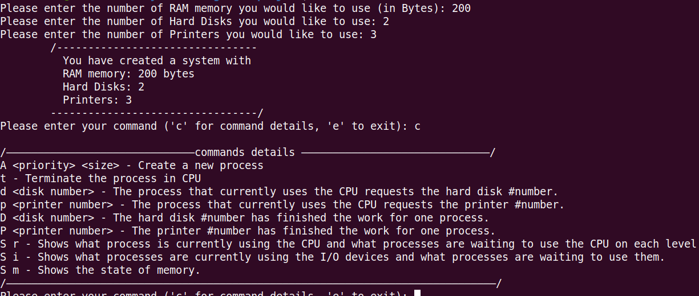
SNAP SHOTS

Slide 8
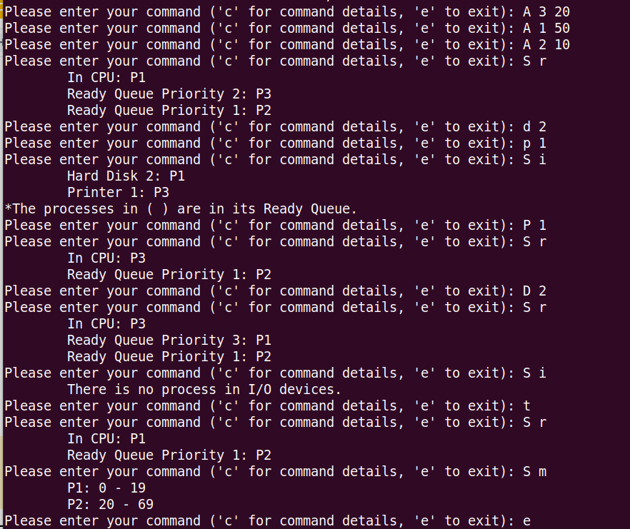

Slide 9
Thank you!

